Slide 1

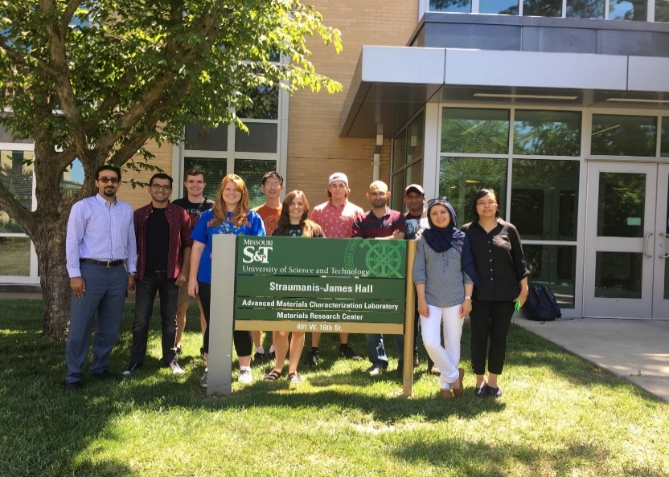

A Machine Learning Approach to Model the Mechanical Response of Metallic Nanofoams
Sepideh Kavousi Department of Mechanical Engineering & Materials Science Program
Colorado School of Mines
ZaeemLab.com

Slide 2
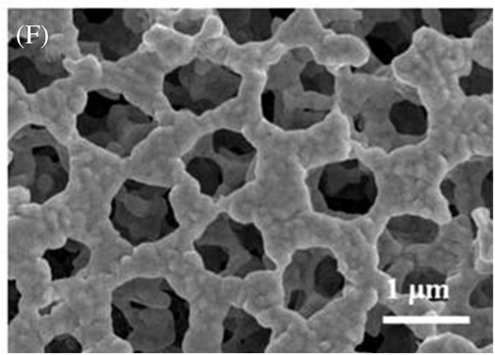
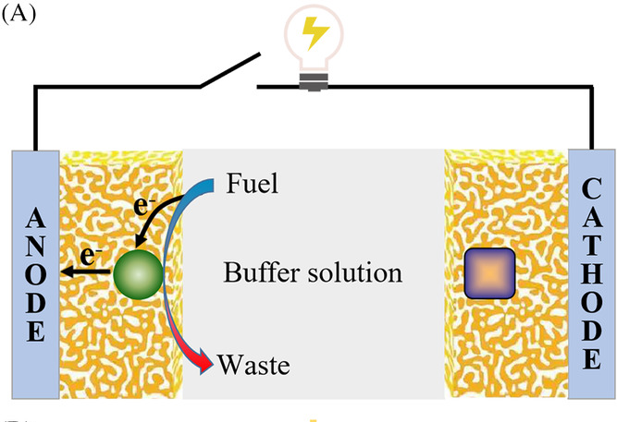
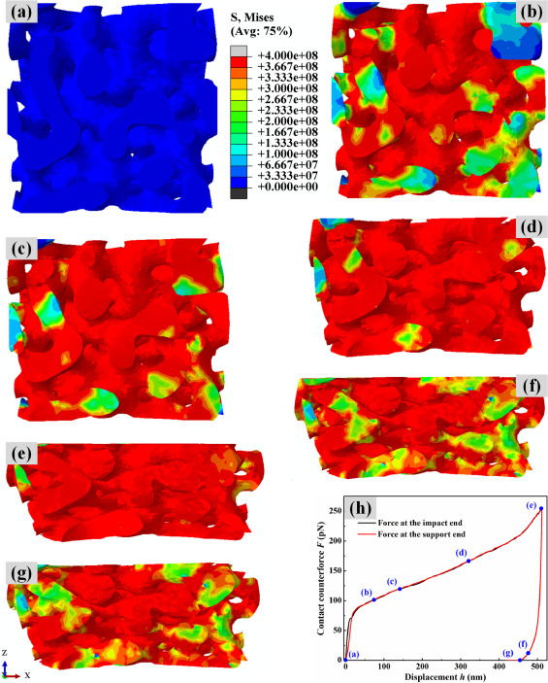
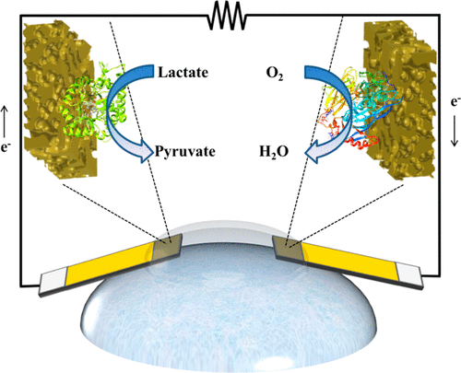


Nanoporous Metal (NPM)
Nanoporous Metals
Xiao et al., Nano Select. 2021; 2: 1437– 1458
APPLICATIONS
Characteristics:
large specific surface area
high porosity
Properties:
high electrical efficiency
excellent energy–absorbing capacity
Biofuel cell electrode
Shock Absorber
Gold Nanoporous material
Goal of this study:
Xiao et al., Nano Select. 2021; 2: 1437– 1458
NPM’s Mechanical
Response
NPM’s
Design
(a)
Data Driven Approach
(b)
(c)
(d)
(e)
(f)
(g)
Xiao et al. , ACS Appl. Mater. Interfaces 2018, 10, 8
Li et al., IJMS, 2021, 192, 106191
2
Notes:
Nanoporous materials refer to materials with pore size between 0.1 and 100 nm, , porosity greater than 40
improvements in the dealloying method leads to manufacturing crack-free NPMs. This enables obtaining good ductility for NPMs.
Application: Biofuel cells are the devices that convert chemical energy of various into electrical energy through electrochemical reactions.
Flexible NPG were successfully fabricated for power supply for wearable electronic devices on Contact Lenses

Slide 3
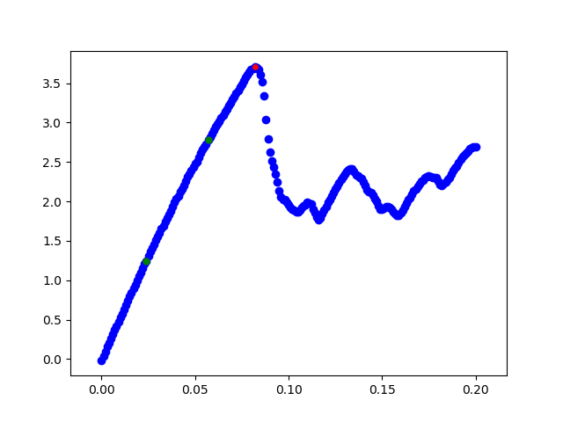
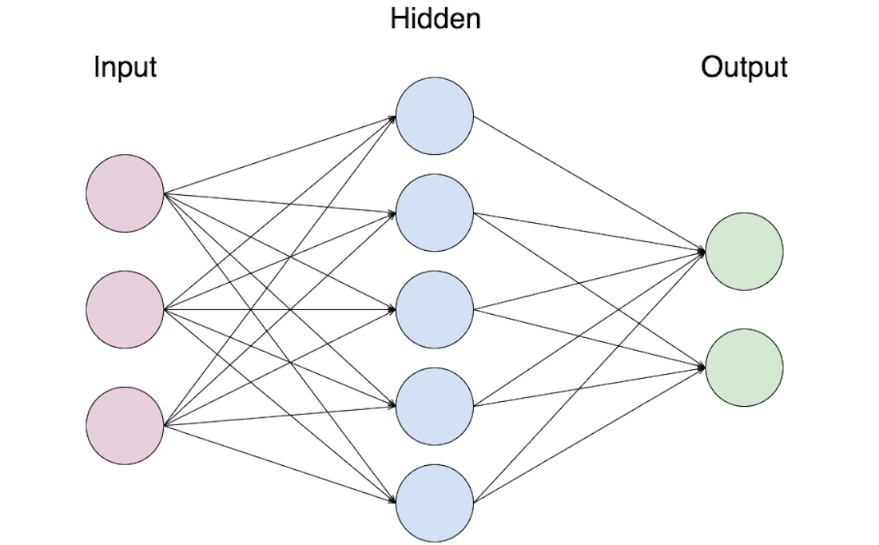
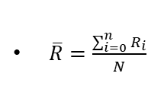
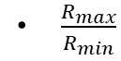
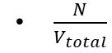
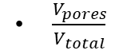
Automated Workflow of Randomized Design & Investigation of Nanofoams Under Tension
Start
σ_{y}
Post-processing the stress-strain behavior using python code
Compression
(stress rate=10⁻³ 1/ps)
Stress (GPa)
E
Create bulk Metal block
ε_{y}
Strain
Equilibrate the nanoporous structure at T
Input Layer:
Neural Network Model
Output Layer:
Choose random # of pores (N)
Hidden
σ_{y}
$\frac{V_{pores}}{V_{total}}$
$\frac{N}{V_{total}}$
Input
Output
ε_{y}
T
Randomly choose temperature (300, 400, 500 K)
$\frac{R_{max}}{R_{min}}$
E
i=0
$\overline{R}=\frac{\sum_{i=0}^{n}{R_{i}}}{N}$
Chose a random radius for i^{th} pore (R_{i})
Is volume of i^{th} pore (V_{i}) > 0.05 × of total volume ?
Yes
total volume of all pores (V_{pores}) >0.1× of total volume?
Yes
delete atoms in i^{th} pore from the bulk block
i=N?
Yes
Finished
structure
i=i+1
No
No
No
3
Notes:
First part is workflow for design the nanopores

Slide 4
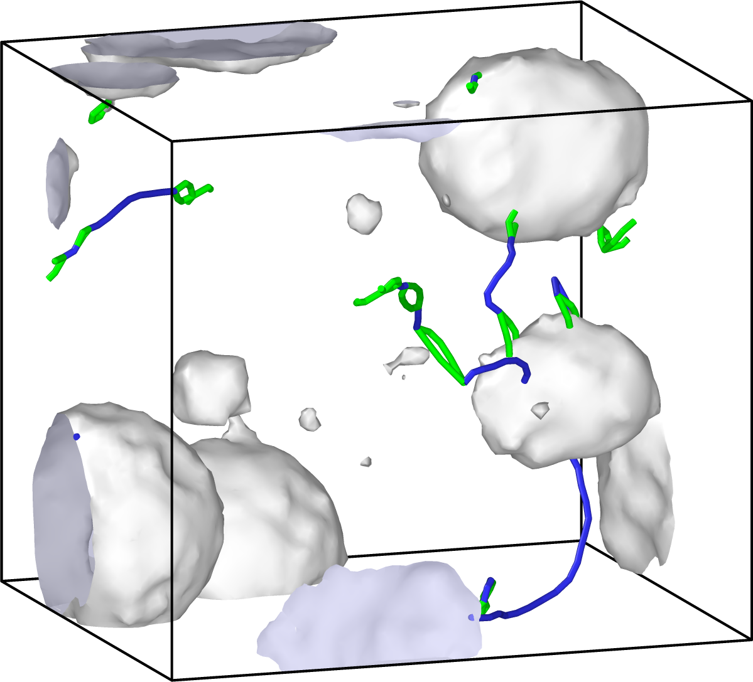
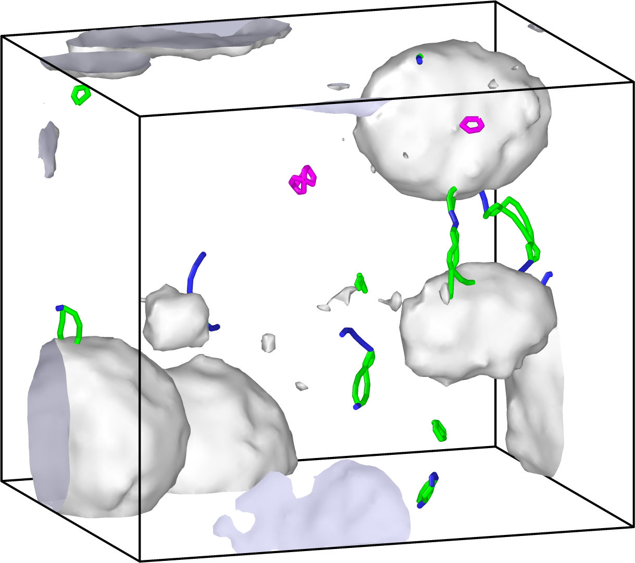
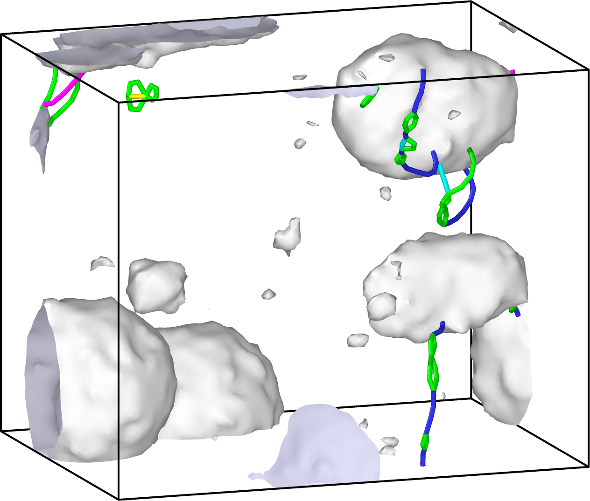
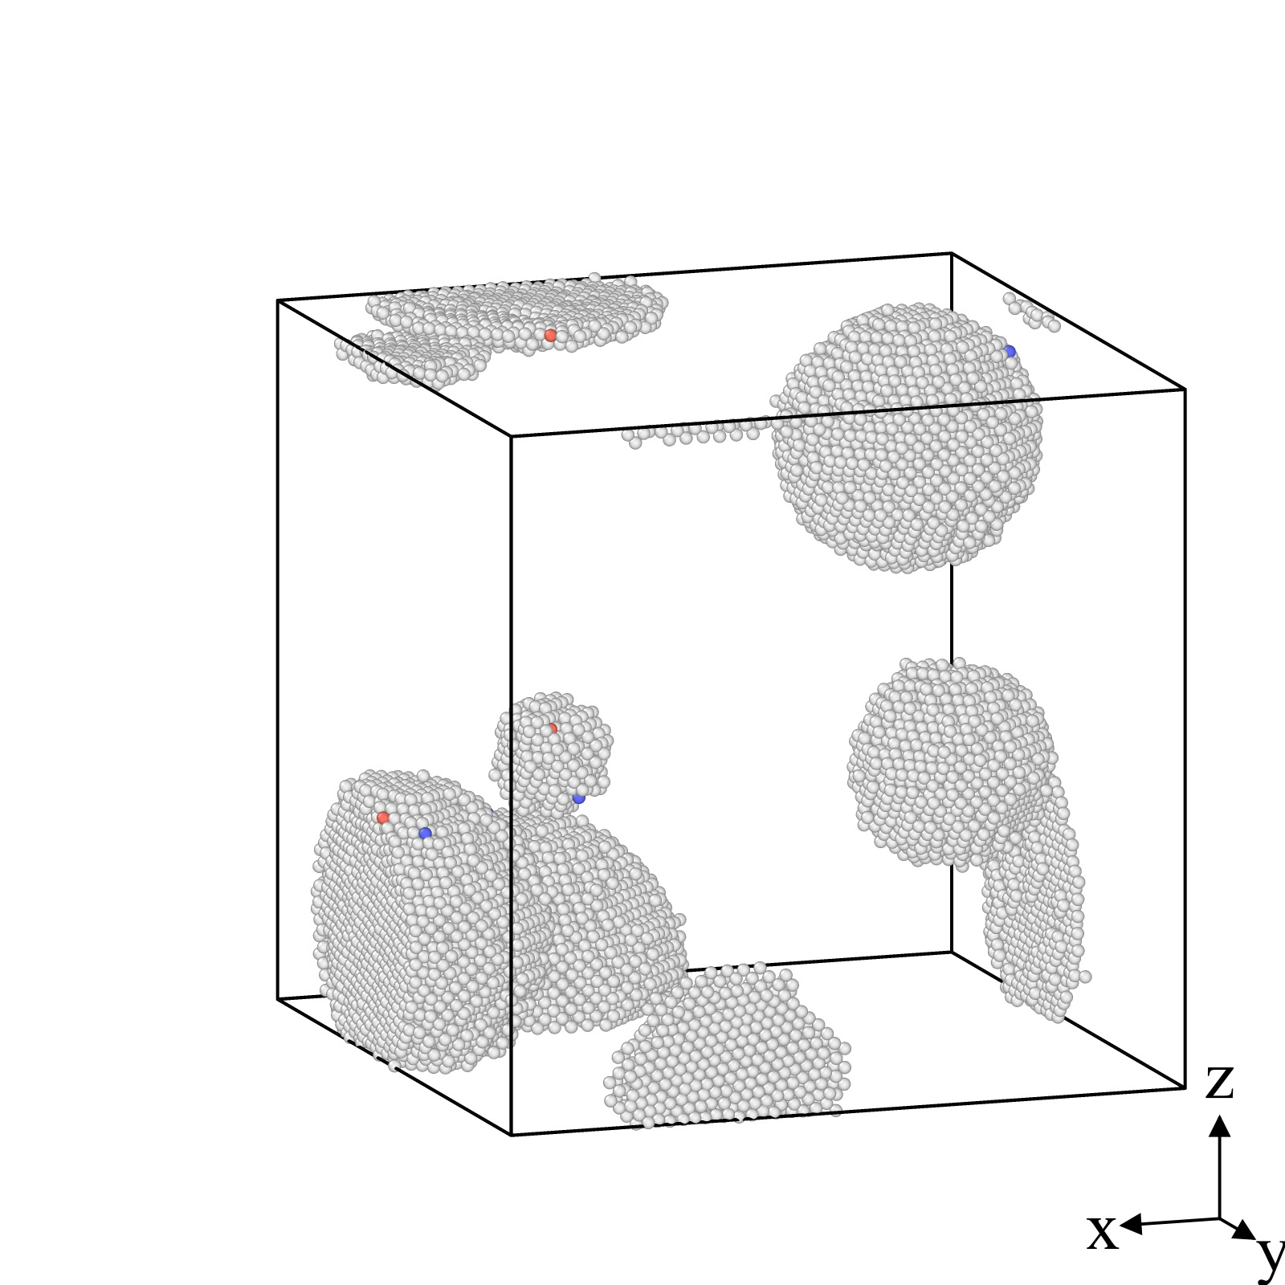
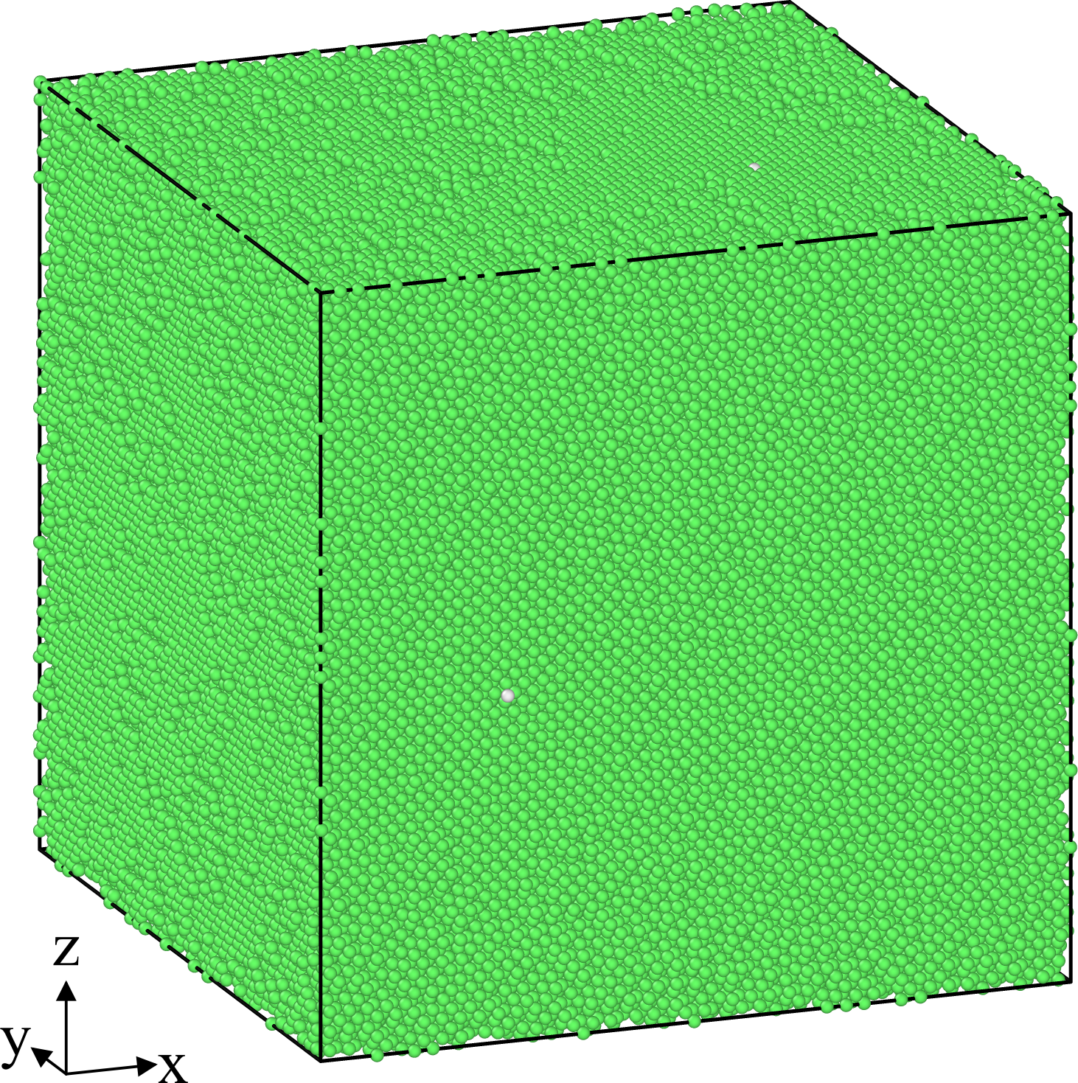
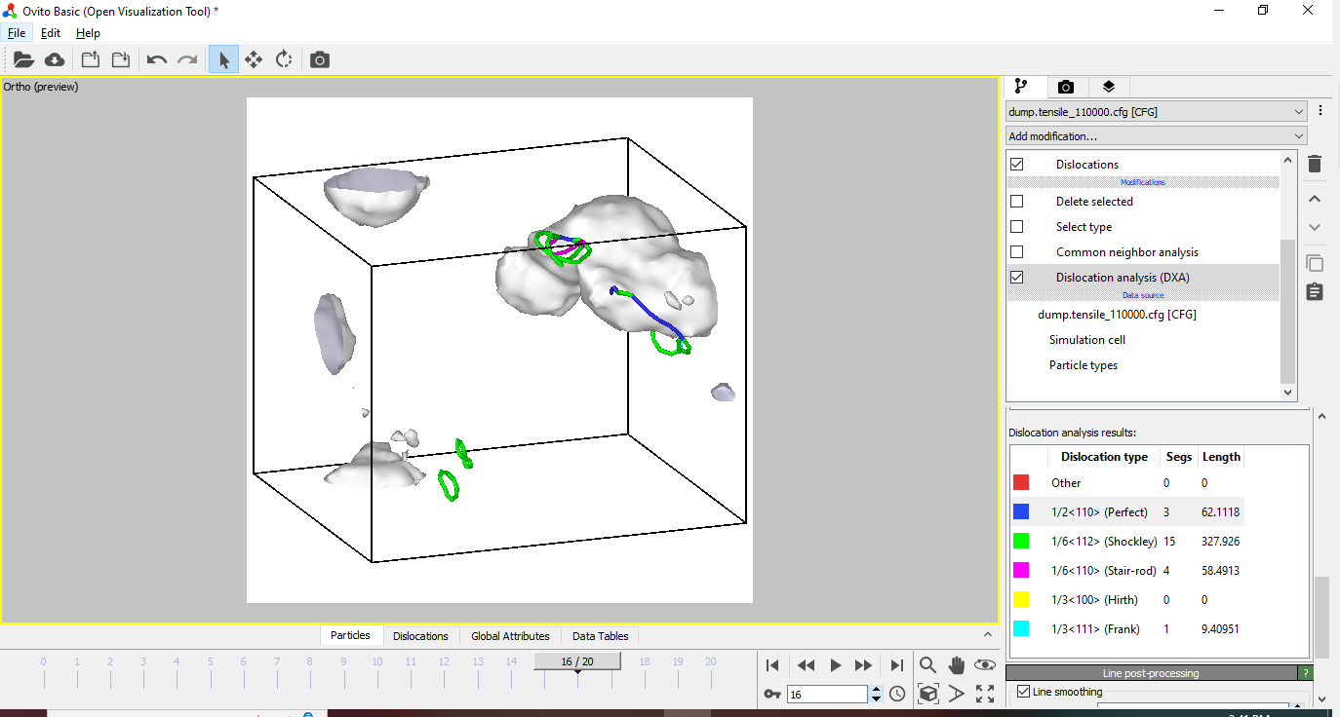
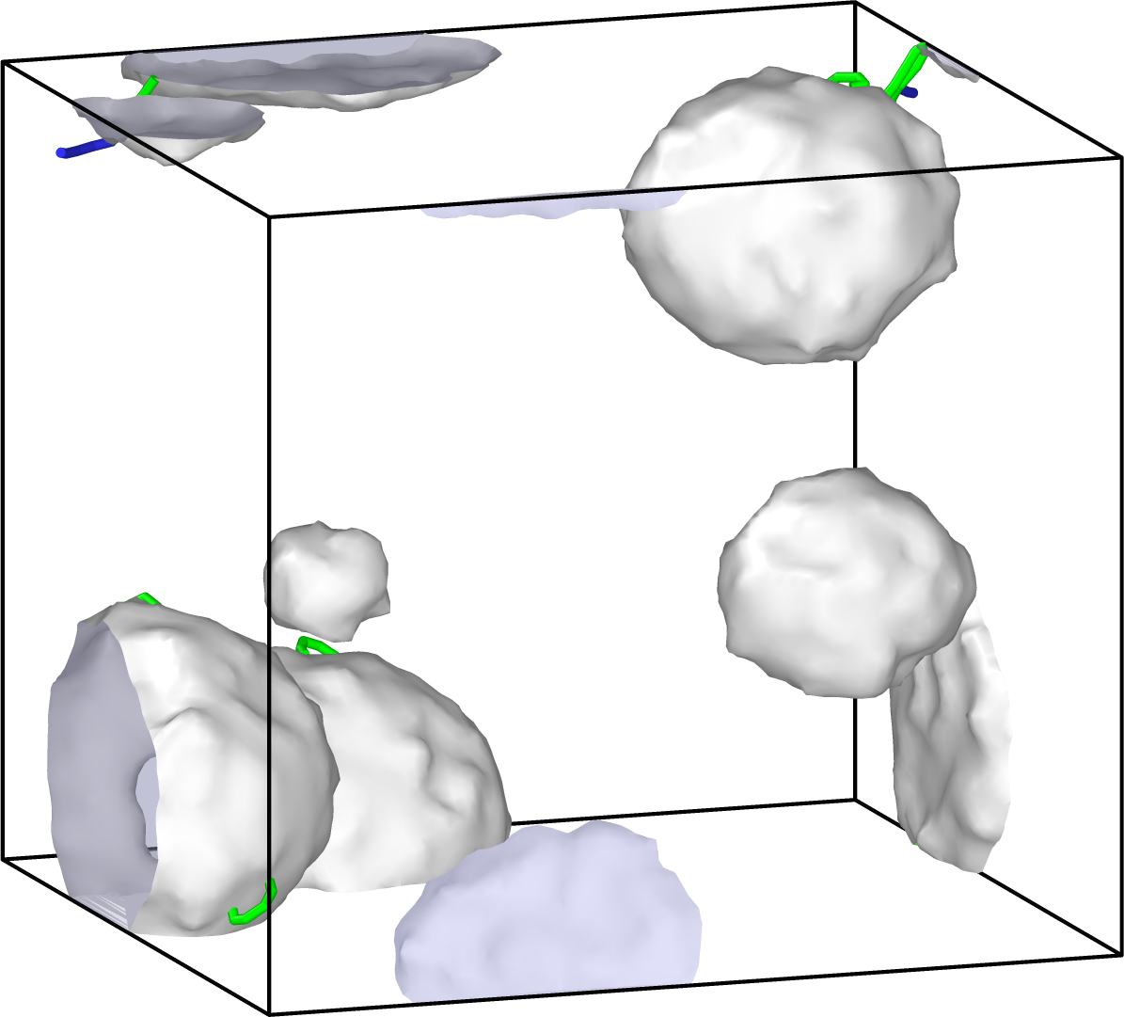
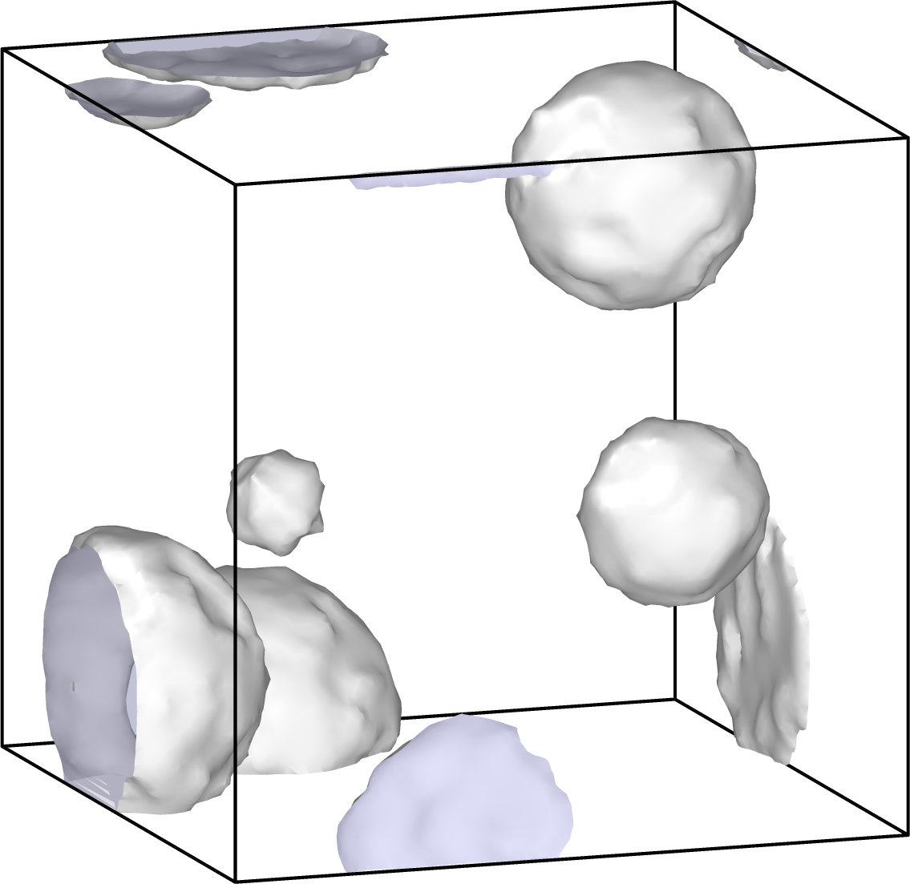
MD Simulation Details
(c) ε=10%
(d) ε=13%
(e) ε=20%
(b) ε=8%
Strain rate=10⁻³ 1/ps
b
e
d
Stress [GPa]
(a) ε=0%
c
a
strain
4
Notes:
MD setup and animation shows how the pores evolve during the tension
Use MEAM potential which predict bulk modulus and elastic modulus
The drop in stress-strain graph corresponds dislocations formed and move inside the bulk material.
Three dislocation types formed

Slide 5
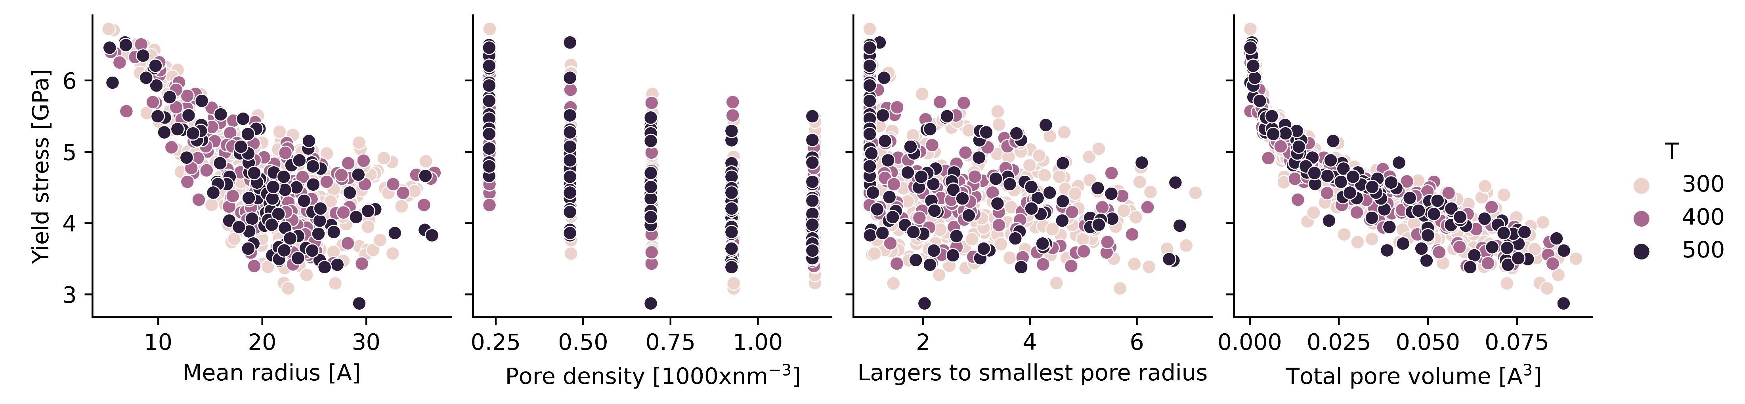
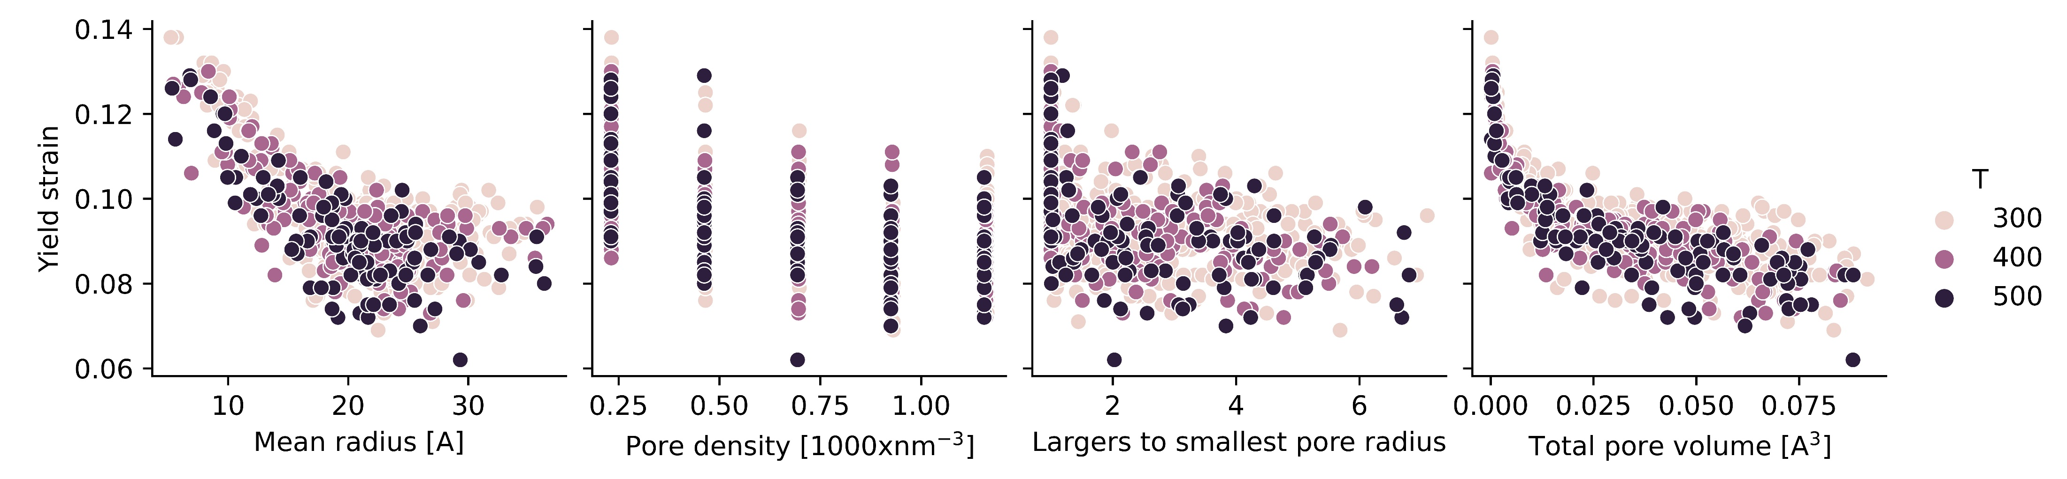
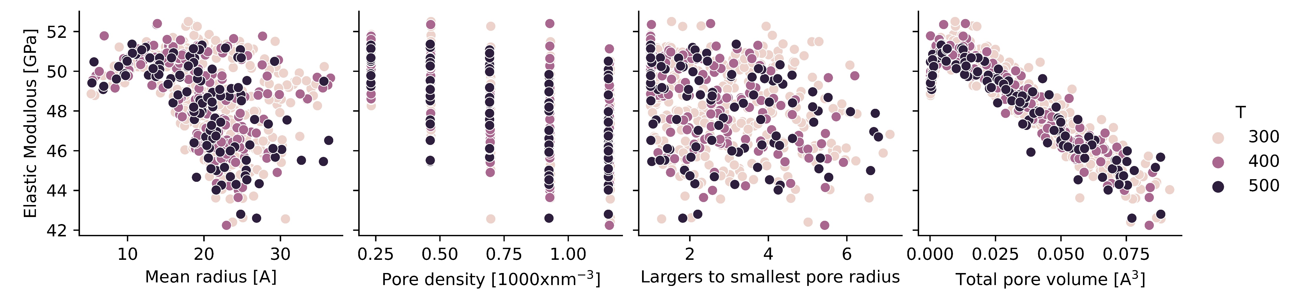
Exploratory Data Analysis
5
Notes:
The complex Correlations between the mechanical properties and design factors highlights importance of using ML models in optimizing the design

Slide 6
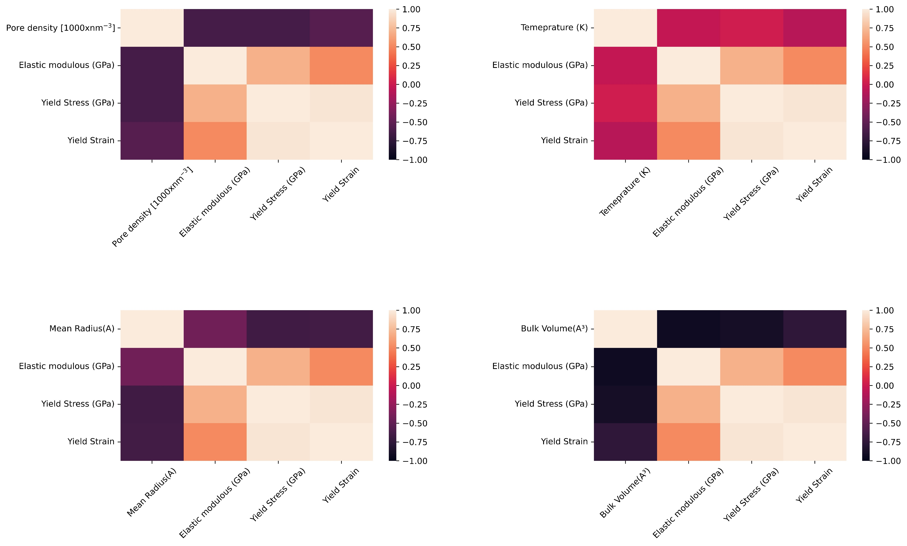
Heatmap
Pearson correlation coefficient:
6
Notes:
The heatmap identify correlation between each design input factor and output parameters.
It is based on pearson correlation coefficnet
It shows the impostance of volume and mean radius and pore density!

Slide 7
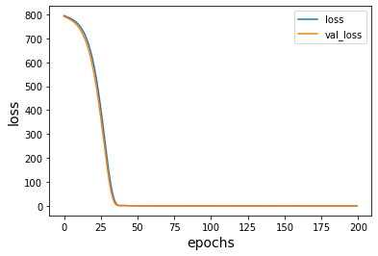
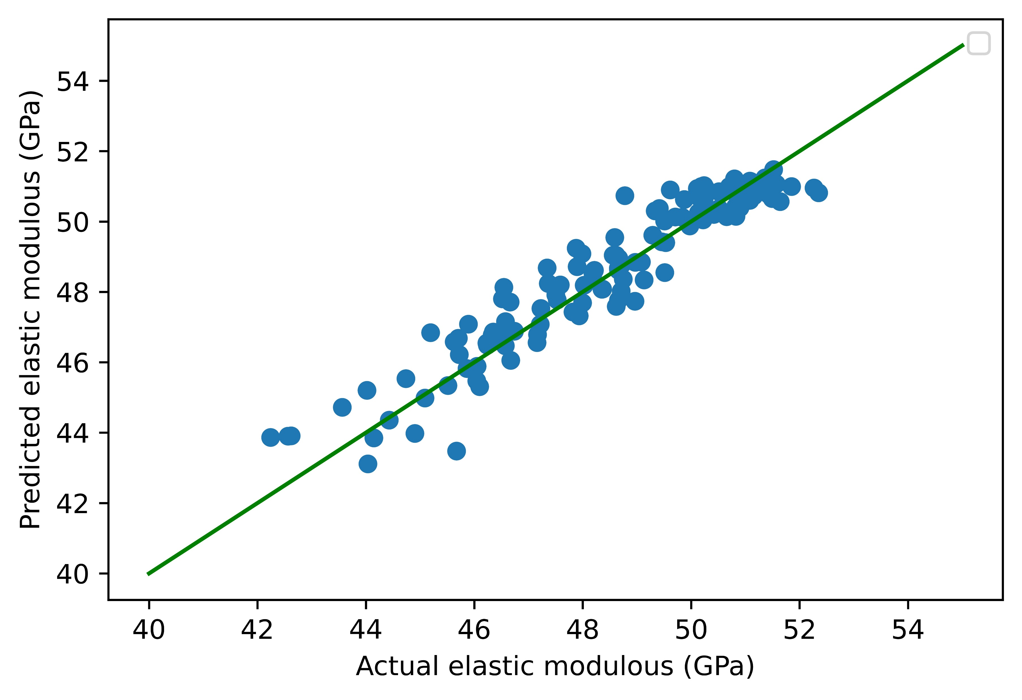
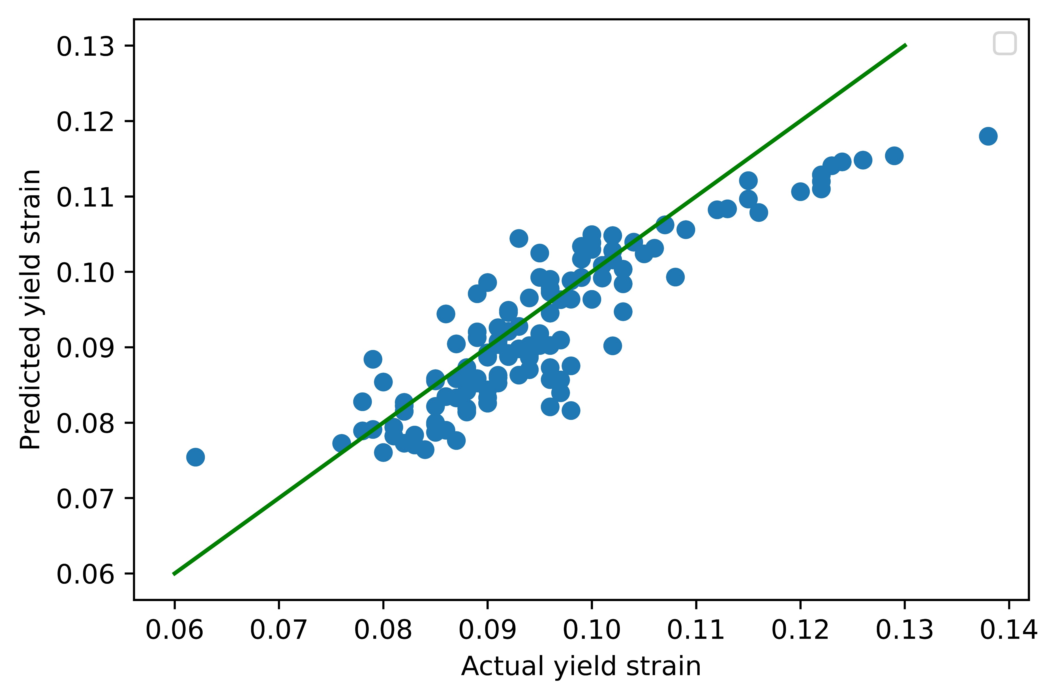
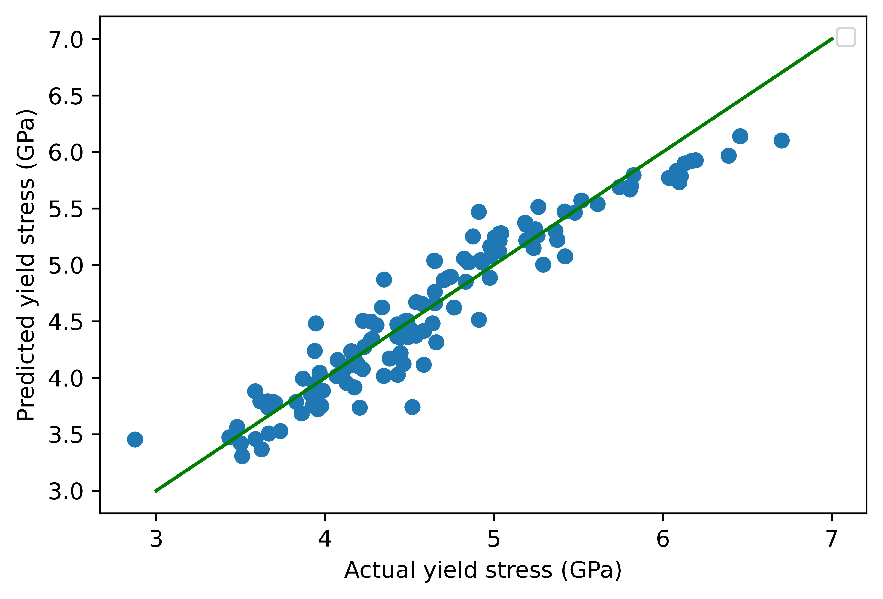
Neural Network (NN) Model Performance
Training and Testing Dataset:
620 Data points
351 runs @T=300K
159 runs @ t=400 K
110 runs @T=500 K
Splitting:
80% train data-20% test data
Test and train have the same proportions of class T
NN model Architecture:
Forward feed
3 hidden layers
20 neurons
Optimized Hyperparameters:
Batch size=100
Epochs=200
Loss function=Mean Squared Error
7
Notes:
loss vs epotchs shows the models performance. loss_val (loss function of validation which is based on test data.)
Hyper parameter Oprimization :Epotch is the number of times the training dataset passes a NN model. Batch size: we train ML models with training datasets with size of 100 data at each NN model parametrization

Slide 8
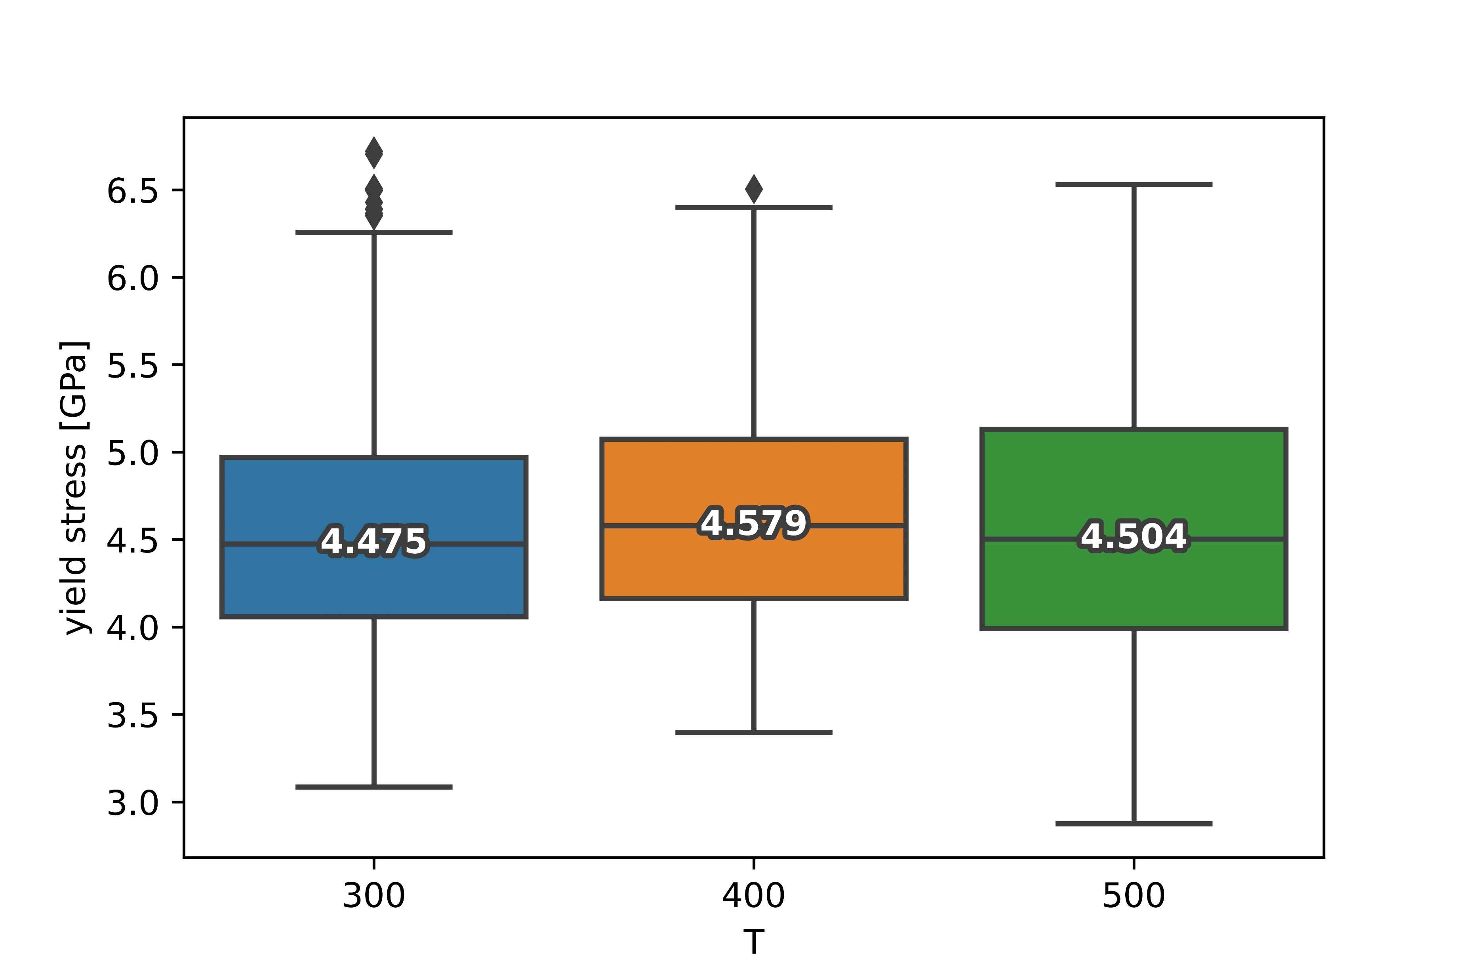
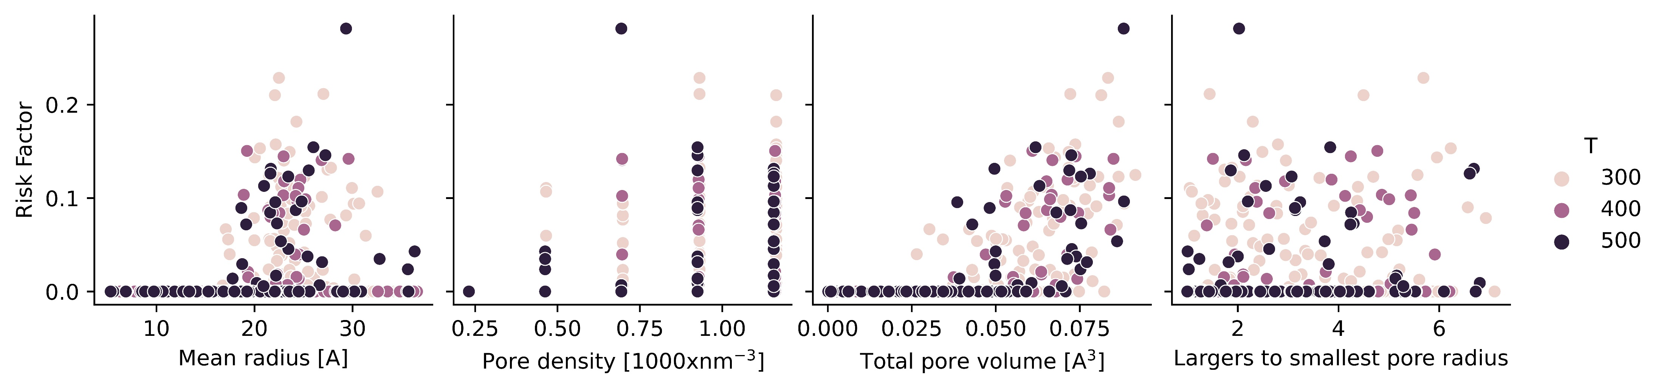
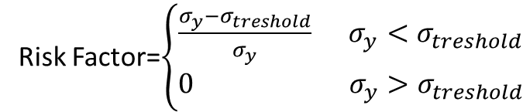
Application of NN Model: Predict the Risk Factor
Summary of Data for yield stress
Risk Factor=$\left\{\begin{aligned}\frac{σ_{y}−σ_{treshold}}{σ_{y}} σ_{y}<σ_{treshold} \\ 0{ σ}_{y}>σ_{treshold}\end{aligned}\right.$
Let’s consider yield stress threshold for an application is 4 GPa
8
Notes:
Box plot: distribution of the data for each temperature
Predict risk factor based on the yield stress and the threshold set by application!
The complex nature of the dependency of risk factor on input design factors

Slide 9
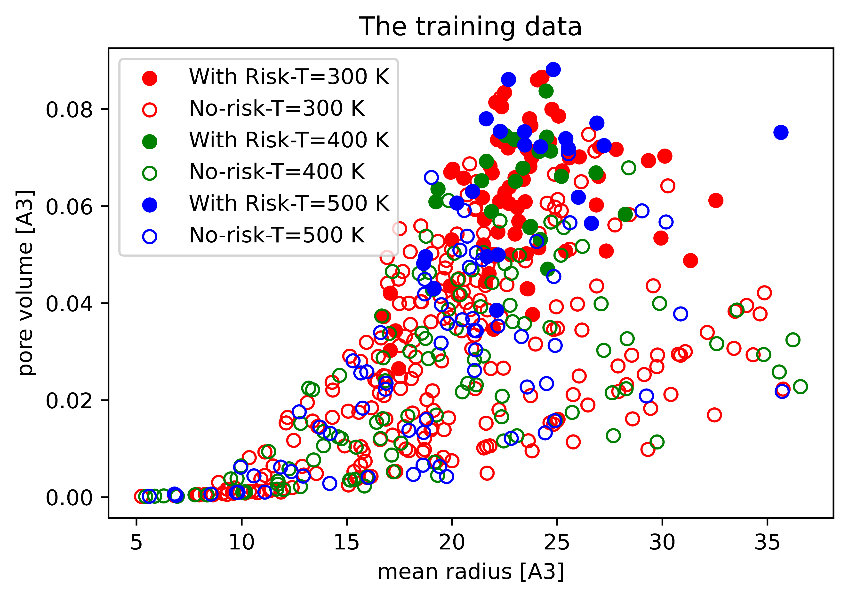
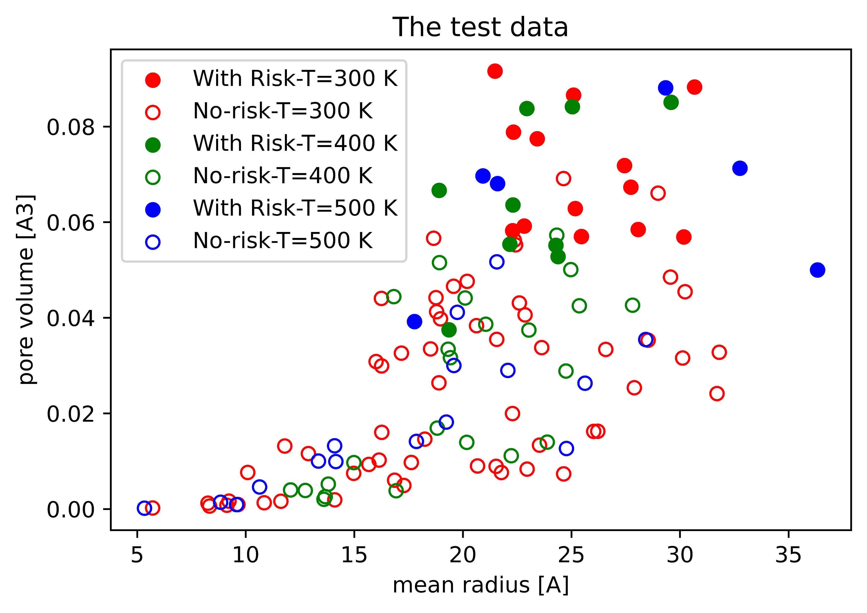
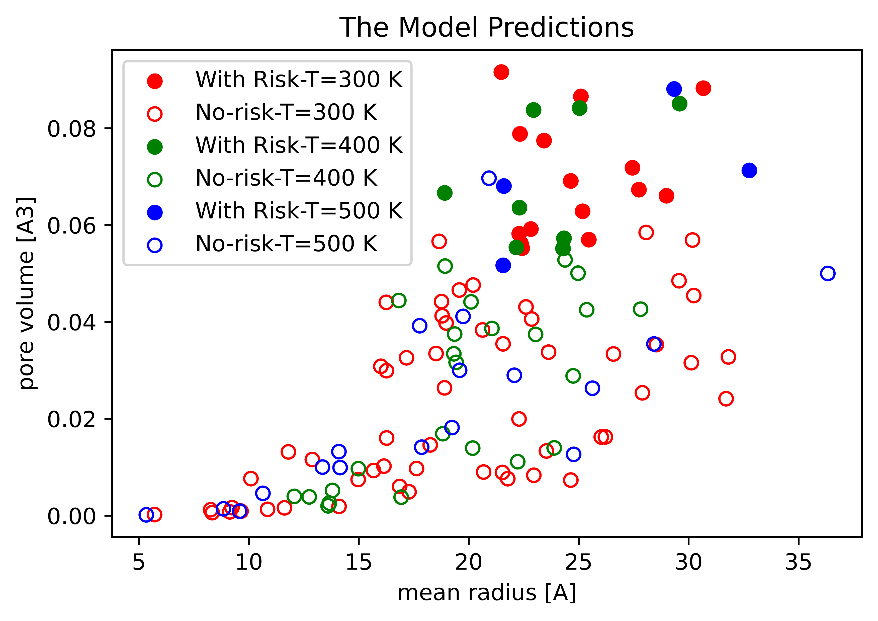
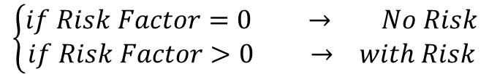
Develop a Classification NN Model: Multi-layer Perceptron (MLP)
Training and Testing Dataset:
620 Data points
351 runs @T=300K
159 runs @ t=400 K
110 runs @T=500 K
Splitting:
80% train data-20% test data
Test and train have the same proportions of class T
MLP model Architecture:
Classification model
3 hidden layers
20 neurons
Hyperparameters:
alpha=1
$$\left\{\begin{aligned}if Risk Factor=0 → No Risk \\ if Risk Factor>0 → with Risk\end{aligned}\right.$$
9
Notes:
The MLP is a classification model which divides each design into two categories: with risk and without risk
Hyperparameter Alpha determines the Regularization, which determines the tradeoff between bias and variance. We will discuss how alpha affects the model predictions later.
Comparing the Test data with model predictions shows the accuracy of the developed NN-MLP model

Slide 10
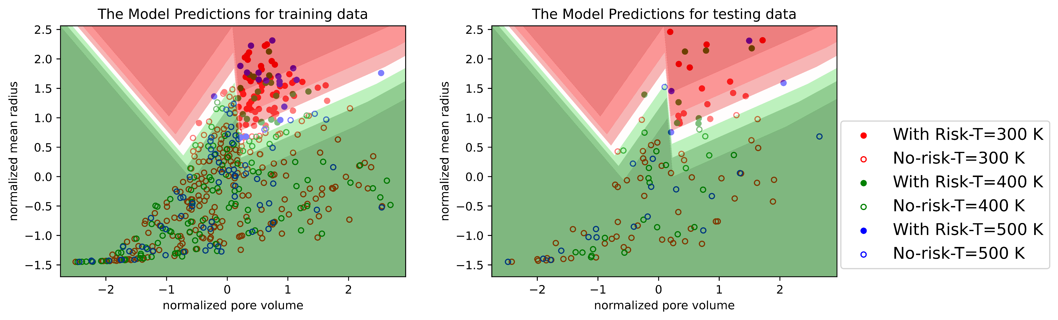
Decision Boundary Plot Based on MLP Model
10
Notes:
The decision boundary plot based on the MLP model for the training data and how it predicts the testing data’s performance.

Slide 11
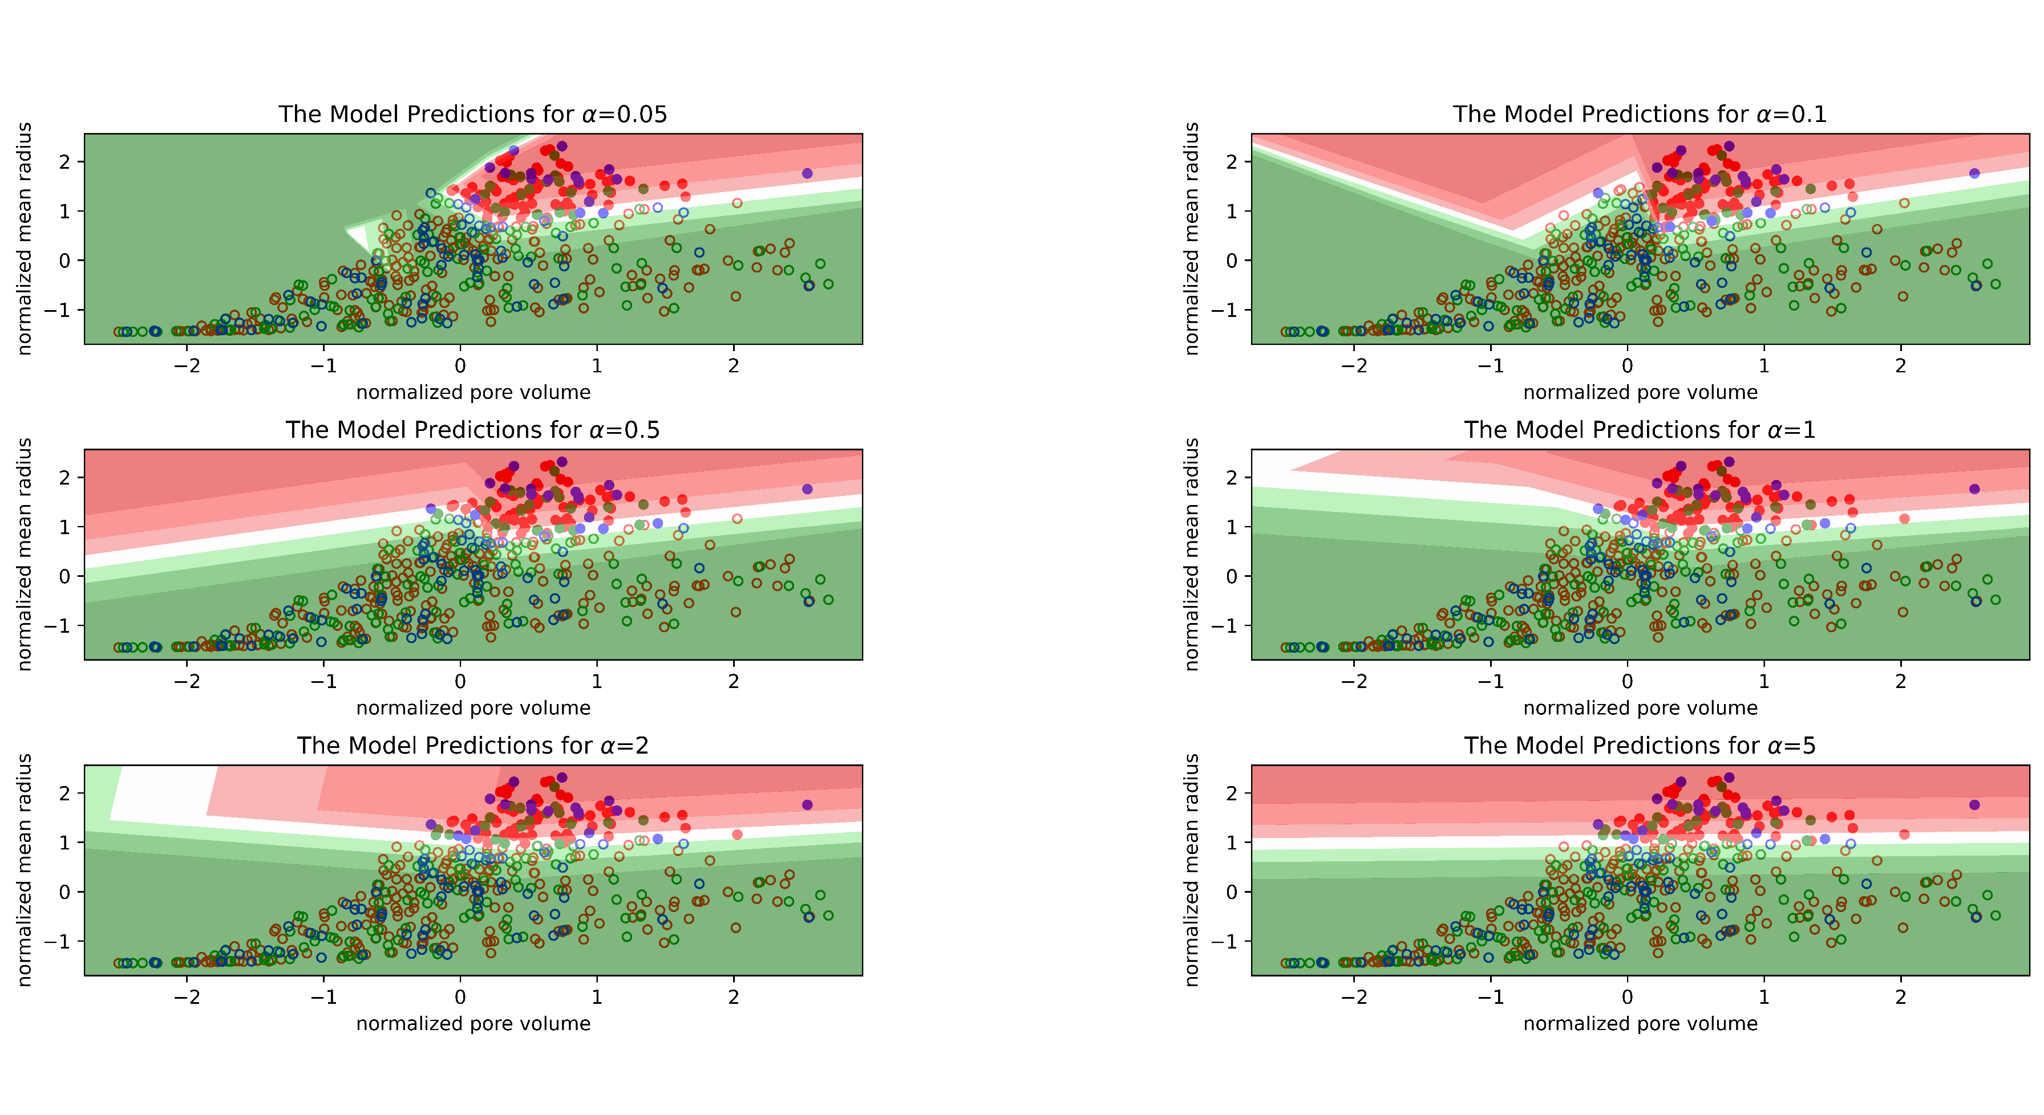

MLP Model Regularization-Training Data
11
Notes:
Regularization combats overfitting by constraining the size of the weights. Alpha is a parameter for regularization term.
Variance is the variations in predictions when the different training dataset is used
Increasing alpha may fix high variance (a sign of overfitting) by encouraging smaller weights, resulting in a decision boundary plot that appears with lesser curvatures. Similarly, decreasing alpha may fix high bias (a sign of underfitting) by encouraging larger weights, potentially resulting in a more complicated decision boundary.

Slide 12
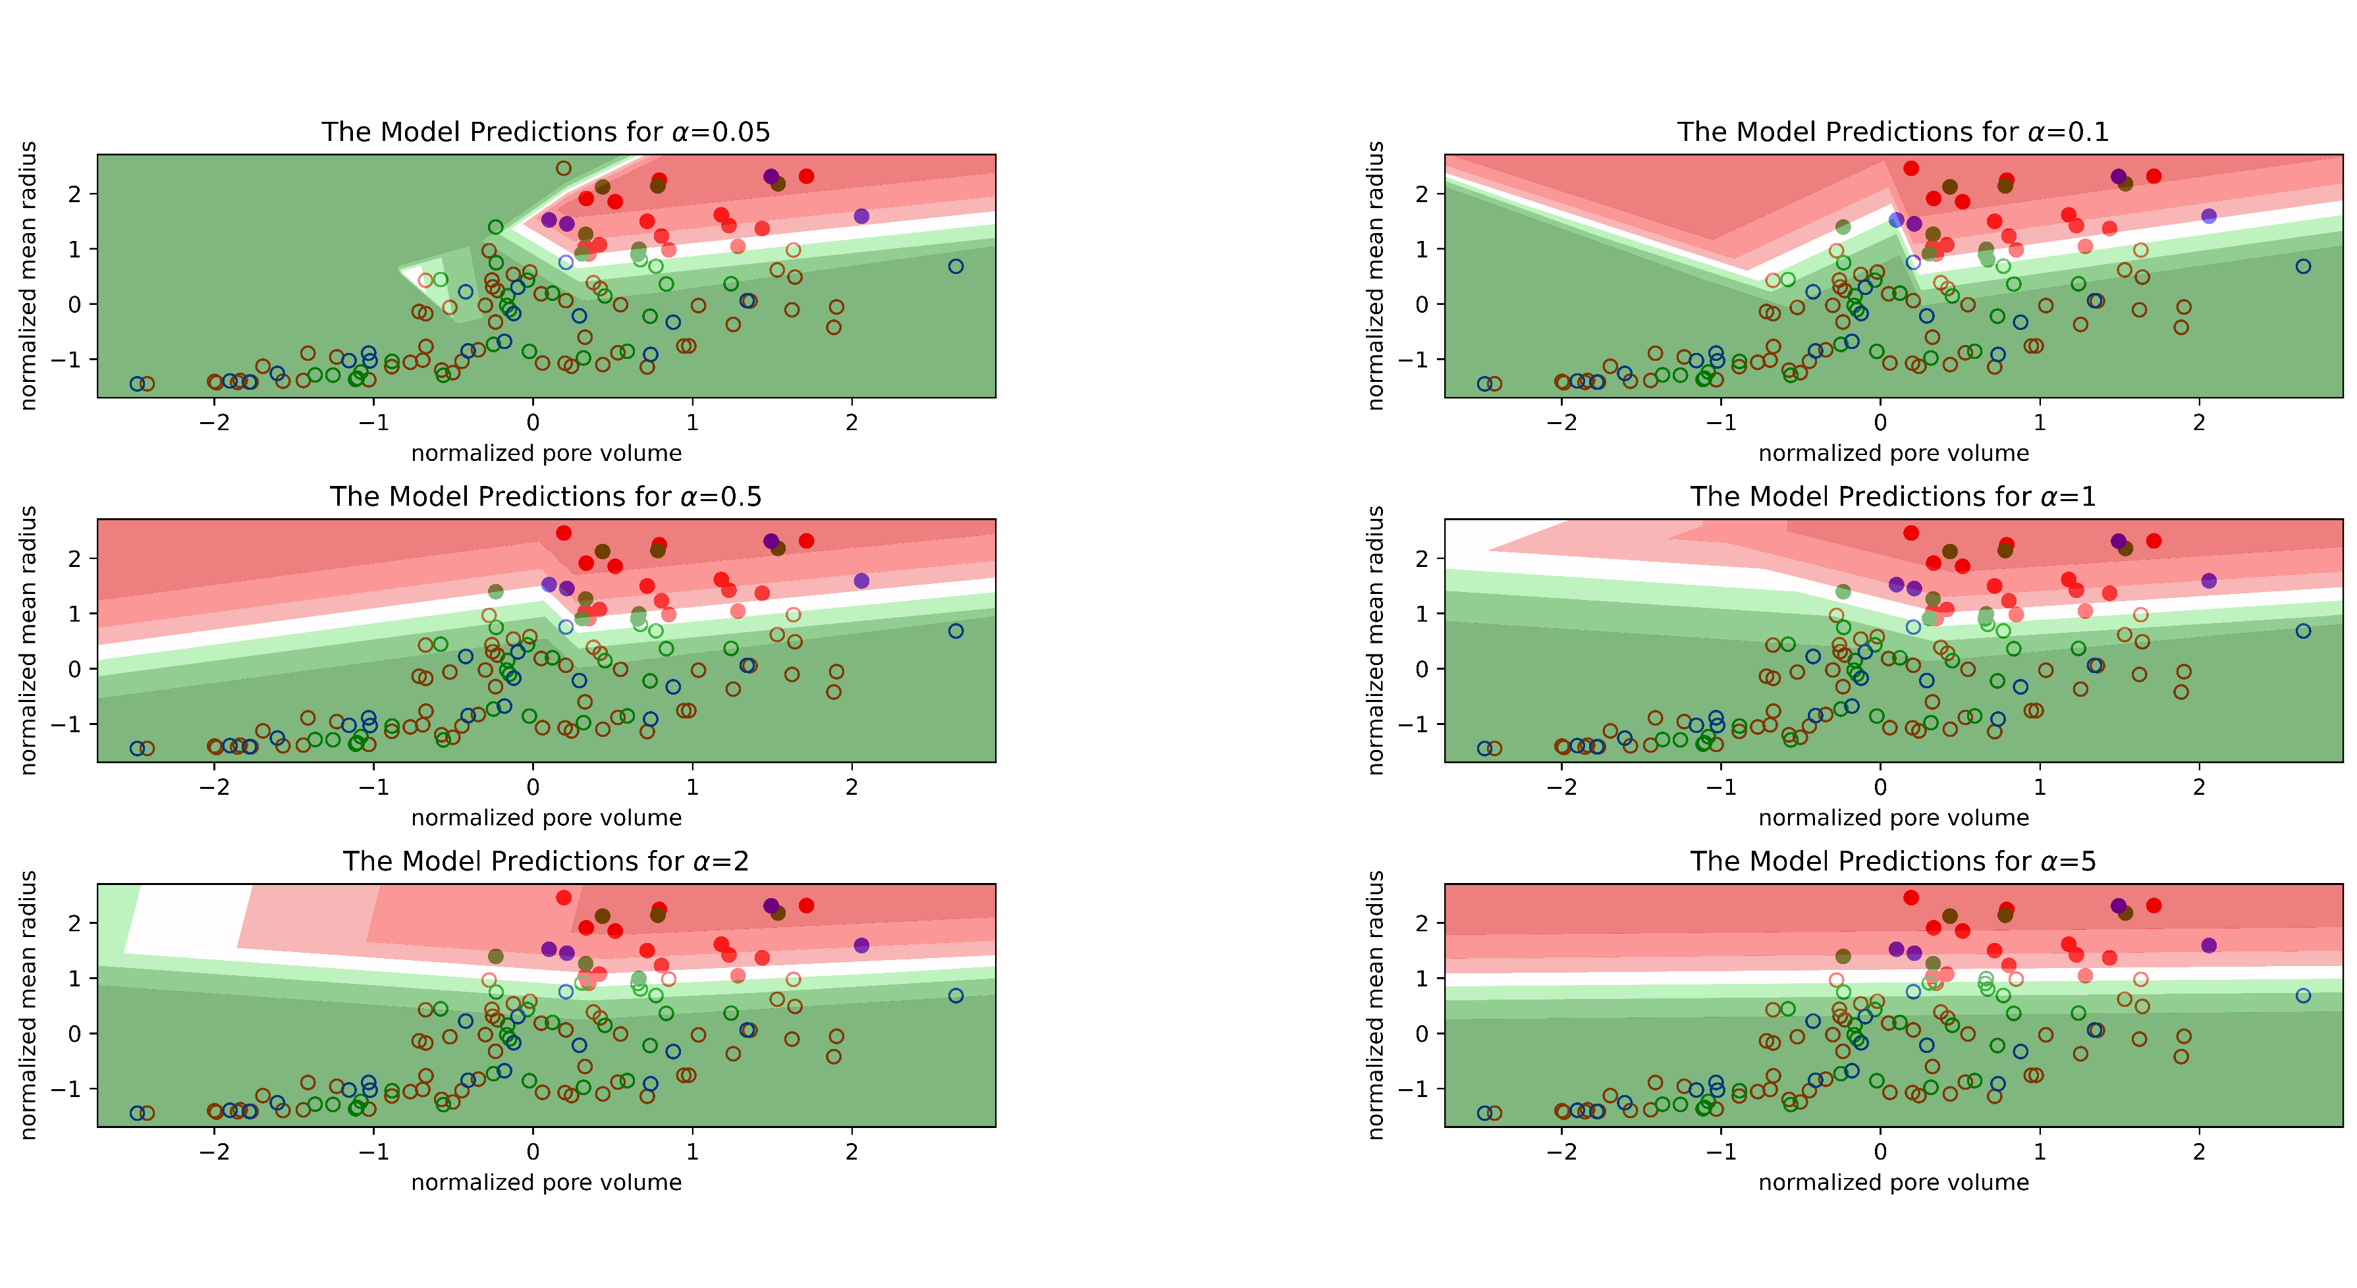
MLP Model Regularization-Testing Data
12
Notes:
This shows how the decision boundary based on the training dataset, can accurately predict the risk/norisk behavior of material
MLP model with lower bias suggests the effect of mean pore radius is more critical that its total volume fraction

Slide 13
Summary and Conclusion
We used a neural network (NN) algorithm to relate the design factors of nanoporous metal (pore density, volume fraction, average size and distribution of pores) to materials mechanical properties (elastic modulus, yield stress, yield strain) at different temperatures.
An NN-MLP model is used obtain a decision boundary plot for the risk factor, which is determined by comparing the yield stress with a yield stress threshold .
The MLP model with lower bias suggests the effect of mean pore radius is more critical with an approximate threshold of approximately 2.5 nm.
In future, we will also investigate how the design factors alter the material’s deformation mechanism during plastic deformation regime.
13

